Slide 1
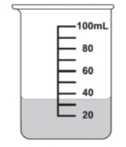

Measurement Interactive Notebook
Name
Class
Teacher
Term 3 Semester 2
1

Slide 2
Contents
Glossary or Formula Page
Page
Date
Description
2
3

Slide 3
Tasks
24
7
30
Essential Question
Questions
Notes
Summary
4
5

Slide 4
Warm up
Solve the following equations:
12=
16=
6=
4=
9=
30
X
X
3
28
X
X
2
27
X

Slide 5
24
7
30
Date
Introduction to Trigonometry
EQ – How do you find the length of the sides of a right angled triangle if you have a given angle size?
Hypotenuse
Opposite
ϴ
Adjacent
5

Slide 6
Cosine (cos)
We use cosine when we have the Hypotenuse and Adjacent lengths.
14cm
The rule we use is:
ϴ
Adjacent
Hypotenuse
10
14
0.714
Cosϴ=
=
=
10cm

Slide 7
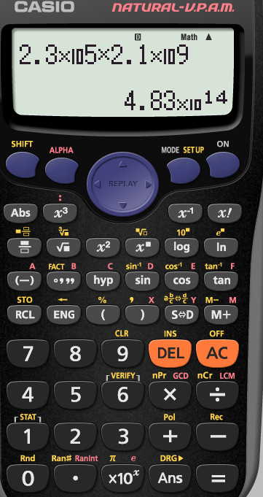
Here are cos and cos ⁻¹

Slide 8
Cosine (cos)
We use cosine when we have the Hypotenuse and Adjacent lengths.
14cm
The rule we use is:
ϴ
Adjacent
Hypotenuse
10
14
0.714
Cosϴ=
=
Cosϴ =
10cm
Cos⁻¹ means “an angle who’s cosine is”
So to find ϴ we find the angle who’s cosine is 0.714

Slide 9
Cosine (cos)
We use cosine when we have the Opposite and Adjacent lengths.
14cm
The rule we use is:
ϴ
Cosϴ = 0.714
ϴ = Cos ⁻¹ 0.714
ϴ = 44.4 degrees
10cm
Check your calculator is set to degrees – if it gave an answer of 0.77 it is set to radians

Slide 10
Cosine (cos)
ϴ
We use cosine when we have the Hypotenuse and Adjacent lengths.
8m
5m
The rule we use is:
Cosϴ = Adjacent
Hypotenuse
Cosϴ = 5
8
ϴ = Cos ⁻¹ 0.625
ϴ = 51.31 degrees

Slide 11
Notes Review
24, 7 ,30
Date
Title
Essential question
Notes complete
Notes complete with colour and diagrams
Questions completed
Contents page filed in
Formula page filled in

